Slide 1
RabbitMQ

Slide 2
RabbitMQ Introduction
RabbitMQ is a message broker
It accepts and forwards messages.
Think about it as a post office: when you put the mail that you want posting in a post box, you can be sure that the letter carrier will eventually deliver the mail to your recipient.
RabbitMQ, and messaging in general, uses some jargon.
Producing means nothing more than sending. A program that sends messages is a producer.
A queue is the name for the post box in RabbitMQ.
Although messages flow through RabbitMQ and your applications, they can only be stored inside a queue.
A queue is only bound by the host's memory & disk limits, it's essentially a large message buffer.
Many producers can send messages that go to one queue, and many consumers can try to receive data from one queue.
Consuming has a similar meaning to receiving. A consumer is a program that mostly waits to receive messages:

Slide 3
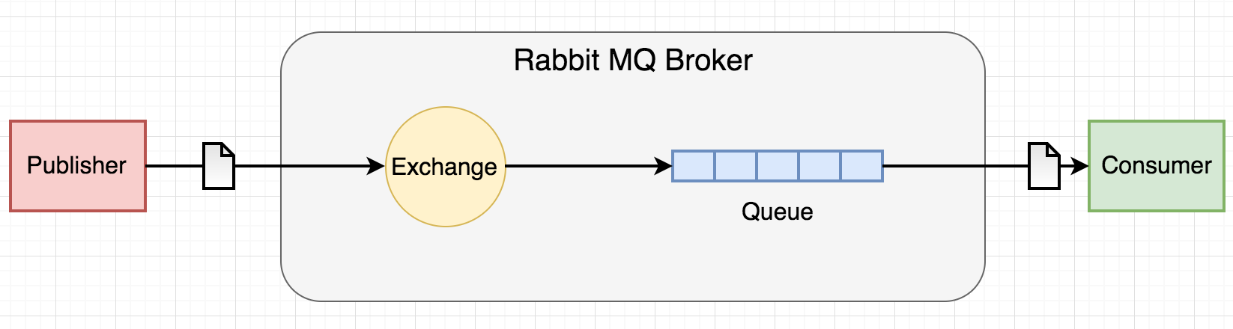
RabbitMQ Architecture

Slide 4
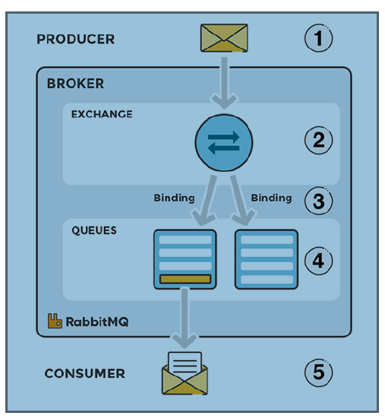
RabbitMQ Architecture
Producers:
Client applications called producers create messages
And publishes them to an exchange on a Rabbit.
Exchange
An exchange accepts messages from the producer application
Routes them to message queues.
Bindings
Bindings have to be created from the exchange to queues.
The exchange routes the message into the queues, depending on message attributes such as routing keys and bindings.
Queues
The messages stay in the queue until other applications, called consumers, connect to that queue and subscribe to the messages.
Consumer
The consumer(s) subscribes to the messages.

Slide 5
RabbitMQ vs Kafka architecture
Kafka vs RabbitMQ | RabbitMQ | Kafka
Performance | 4K-10K messages per second | 1 million messages per second
Message Retention | Acknowledgment based | Policy-based (e.g., 30 days)
Data Type | Transactional | Operational
Consumer Mode | Smart broker/dumb consumer | Dumb broker/smart consumer
Topology | Exchange type: Direct, Fan out, Topic, Header-based | Publish/subscribe based
Payload Size | No constraints | Default 1MB limit
Usage Cases | Simple use cases | Massive data/high throughput cases

Slide 6
RabbitMQ vs Kafka messages
Tool | RabbitMQ | Apache Kafka
Delivery Guarantee | Especially in relation to transactions utilizing a single queue, it does not guarantee atomicity. | Only keeps order within a partition. Kafka ensures that every message in a partition either succeeds or fails.
Message ordering | Unsupported. | Message ordering is provided via its partitioning. By message key, messages are sent to topics.
Message priorities | You can set message priorities in RabbitMQ and consume messages in the order of highest priority. | Unavailable
Message lifetime | Because RabbitMQ is a queue, messages are discarded after being read, and an acknowledgment is given. | Since Kafka is a log, messages are kept on file by default. This can be controlled by defining a retention policy.

Slide 7
END

